Slide 1
Real Deal Cars
Under the Guidance of, Submitted by,
Sr. Elsin Chakkalackal S H Timin Kurian
S6 Reg MCA
Roll No: 51

Slide 2
INTRODUCTION
This project is intended to design and develop a website for car service and sales. The project provides the facility for sales of used cars with cent percent quality assurance.
The registered customers can find the nearby service centres and book services. The registered customers can sell their used cars through the site. The site includes the facility of selling only the cars that have serviced in the registered service centres.
The main advantage of the proposed system is that it avails the full service history of the cars for the interested buyers, so that they can chose the best of them. This facility ensures the descent deal for the sellers too. The registered service centres can provide the complete history of their servicing that has done in their centre.

Slide 3
MODULES
There are 3 modules:
Customer
Admin
Service centers
1. Customer
Register cars
View service schemes
Book an appointment
View service history their own cars
Sell vehicle
Chat with buyers or owners
View the cars for sales
View the service history of the interested cars
Compare cars

Slide 4
2. Service centres
Register Service centre
Add service scheme
Add service history
Manage appointments
Leave management
3. Admin
Approve service centres
Approve the registration of cars
Overall management of the website
Add Brands, Cars, and Variants

Slide 5
Table Design
Table no: 1
Table name: tbl_ login
Primary key: user_id
Sl. No | Field name | Field type | Size | Constraints | Description
1. | user_id | int | 10 | Primary key | User id
2. | email | varchar | 30 | Not Null | E-mail
3. | password | varchar | 100 | Not Null | Password
4. | user_type | int | 2 | Not Null | User type
5. | status | int | 1 | Not Null | Status of user

Slide 6
Table no:2
Table name: tbl_users
Foreign key: user_id, place_id
Sl. No | Field name | Field type | Size | Constraints | Description
1. | user_id | int | 10 | Foreign Key | User id
2. | place_id | int | 10 | Foreign key | Place id
3. | first_name | varchar | 15 | Not Null | First name
4. | last_name | varchar | 15 | Not Null | Last name
5. | mobile | int | 10 | Not Null | Mobile Number
6. | photo | varchar | 50 | Not null | Profile photo

Slide 7
Table No: 3
Table Name: tbl_Servicecenter
Primary key: licenceno
Foreign key: user_id, place_id
Sl. no | Fieldname | Field type | Size | Constraints | Description
1 | licenceno | Varchar | 10 | Primary key | License number of service center
2 | user_id | int | 10 | Foreign Key | Login id
3 | place_id | int | 10 | Foreign key | Place id
4 | brandid | int | 10 | Foreign key | Brand id
5 | center_name | varchar | 25 | Not Null | Center name
6 | certificate | varchar | 30 | Not Null | License certificate
7 | mobile | int | 15 | Not Null | Mobile number

Slide 8
Table No: 4
Table Name: tbl_District
Primary Key: district_id
Table No: 5
Table Name: tbl_place
Primary Key: place_id
Foreign key: district_id
Sl. no | Fieldname | Field type | Size | Constraints | Description
1. | district_id | int | 2 | Primary key | District id
2. | district_name | Varchar | 15 | Not Null | District name
Sl. no | Field name | Fieldtype | Size | Constraints | Description
1. | place_id | int | 10 | Primary key | Place id
2. | district_id | int | 2 | Foreign key | District id
3. | place_name | varchar | 25 | Not Null | Place name

Slide 9
Table No: 6
Table Name: tbl_brand
Primary Key: brandid
Table No:7
Table Name: tbl_model
Primary Key: model_id
Foreign Key: brandid
Sl. no | Field name | Field Type | Size | Constraints | Description
1. | brandid | int | 10 | Primary Key | Brand id
2. | brand_name | varchar | 10 | Primary key | Brand name
Sl. no | Field name | Field type | Size | Constraints | Description
1. | model_id | int | 10 | Primary key | Model id
2. | brandid | int | 10 | Foreign key | Brand id
3. | model_name | varchar | 10 | Foreign key | Model name

Slide 10
Table No: 8
Table Name: tbl_variant
Primary Key: variant_id
Foreign Key: model_id, fuel_id
Table No: 9
Table Name: tbl_fuel
Primary Key: fuel_id
Sl. no | Field name | Field Type | Size | Constraints | Description
1. | variant_id | int | 10 | Primary Key | Variant id
2. | model_id | int | 10 | Foreign key | Model id
3. | fuel_id | int | 2 | Foreign key | Fuel id
4. | variant_name | varchar | 15 | Not Null | Variant
Sl. no | Field name | Field type | Size | Constraints | Description
1. | fuel_id | int | 2 | Primary Key | Fuel id
2. | fuel | varchar | 10 | Not null | Fuel type

Slide 11
Table No:10
Table Name: tbl_servicescheme
Primary Key: scheme_id
Foreign Key: licenceno, variant_id, department_id, action_id
Sl. no | Field name | Field type | Size | Constraints | Description
1. | scheme_id | int | 5 | Primary Key | Service scheme id
2. | licenceno | varchar | 25 | Foreign key | License number
3. | variant_id | int | 10 | Foreign key | Variant id
4. | department_id | int | 10 | Foreign key | Department id
5. | action_id | int | 10 | Foreign key | Action id
6. | scheme_name | varchar | 10 | Not null | Service scheme name
7. | price | int | 10 | Not null | Price

Slide 12
Table No: 11
Table Name: tbl_department
Primary Key: department_id
Table No: 12
Table Name: tbl_count
Primary Key: counted
Sl. no | Field name | Field type | Size | Constraints | Description
1. | department_id | int | 10 | Primary Key | Department id
2. | department_name | Varchar | 25 | Not null | Department type
3. | employee_max | int | 5 | Not null | Maximum no of employees
Sl. no | Field name | Field type | Size | Constraints | Description
1. | countid | int | 10 | Primary key | Count id
2. | department_id | int | 10 | Foreign key | Department id
3. | date | date |  | Not null | Date
4. | count | int | 5 | Not null | Work count

Slide 13
Table No: 13
Table Name: tbl_car
Primary Key: carid
Foreign Key: user_id, variant_id
Sl. no | Field name | Field type | Size | Constraints | Description
1. | carid | Int | 10 | Primary key | Car id
2. | user_id | int | 10 | Foreign key | User id
3. | variant_id | int | 10 | Foreign key | Variant id
4. | manufacture_year | int | 10 | Not null | Manufacturing year
5. | color | varchar | 10 | Not null | Car color
6. | regno | varchar | 20 | Not null | Registration number
7. | engineno | varchar | 18 | Not null | Engine number
8. | chasisno | varchar | 18 | Not null | Chasis number
9. | rcbook | varchar | 30 | Not null | Rc book image
10. | photo | varchar | 30 | Not null | Car image
11. | status | int | 10 | Not null | Status

Slide 14
Table No: 14
Table Name: tbl_images
Primary Key: image_id
Foreign Key: user_id
Sl. No | Field name |  | Field type | Size | Constraints |  | Description
1. | image_id | int |  | 10 | Primary key | Image id
2. | user_id | int |  | 10 | Foreign key | User id
3. | car_id | int |  | 10 | Foreign key | Car id
4. | photo | varchar |  | 100 | Not null | Car image

Slide 15
Table No: 15
Table Name: tbl_appointment
Primary Key: apid
Foreign Key: carid, scheme_id, licenceno
Sl. No | Field name | Field type | Size | Constraints | Description
1. | appointment_id | int | 10 | Primary key | Appointment id
2. | carid | int | 10 | Foreign key | Car id
3. | scheme_id | int | 10 | Foreign key | Scheme id
4. | licenseno | varchar | 20 | Foreign key | Service center license number
5. | appointment_date | date |  | Not null | Date
6. | remarks | varchar | 50 | Not null | Remarks from service center
7. | km | int | 10 | Not null | Odometer reading
8. | appointment_time | varchar | 20 | Not null | Appointment time
9. | delivery_date | date |  | Not null | Delivery date
10. | delivery_time | varchar | 20 | Not null | Delivery time
11. | status | int | 1 | Not null | Appointment status

Slide 16
Table No: 16
Table Name: tbl_action
Primary Key: action_id
Table No: 17
Table Name: rdc_tbl_sales
Primary Key: saleid
Foreign Key: carid, user_id
Sl. No | Field name | Field type | Size | Constraints | Description
1. | action_id | int | 10 | Primary key | Action id
2. | action_name | varchar | 20 | Not null | Action name
3. | replaced | varchar | 50 | Not null | Replaced parts
4. | checked | varchar | 50 | Not null | Inspected parts
Sl. No | Field name | Field type | Size | Constraints | Description
1. | saleid | int | 10 | Primary key | Sales id
2. | carid | int | 10 | Foreign key | Car id
3. | user_id | int | 10 | Foreign key | User id
4. | km | int | 10 | Not null | Odometer reading
5. | remarks | varchar | 50 | Not null | Remarks of owner

Slide 17
Table No: 18
Table Name: tbl_payment
Primary Key: transaction_id
Foreign Key: user_id, licenceno
Sl. No | Field name | Field type | Size | Constraints | Description
1. | transaction_id | int | 10 | Primary key | Transaction id
2. | user_id | int | 10 | Foreign key | Paid by
3. | licenceno | varchar | 15 | Foreign key | Paid to
4. | transaction_date | date |  | Not null | Date
5. | amount | int | 10 | Not null | Amount paid
6. | status | int | 10 | Not null | Payment status

Slide 18
Table No: 19
Table Name: tbl_employee
Primary Key: employee_id
Foreign Key: licenceno, department_id
Sl. No | Field name | Field type | Size | Constraints | Description
1. | employee_id | int | 10 | Primary key | Employee id
2. | licenceno | varchar | 15 | Foreign key | Service center licence number
3. | department_id | int | 10 | Foreign key | Department id
4. | employee_fname | varchar | 25 | Not null | Employee first name
5. | employee_lname | varchar | 25 | Not null | Employee last name

Slide 19
Table No: 20
Table Name: tbl_leave
Primary Key: leave_id
Foreign Key: employee_id
Sl. No | Field name | Field type | Size | Constraints | Description
1. | leave_id | int | 10 | Primary key | Leave id
2. | employee_id | int | 10 | Foreign key | Employee id
3. | date | date |  |  | Date of leave
4. | reason | varchar | 50 | Not null | Leave reason

Slide 20
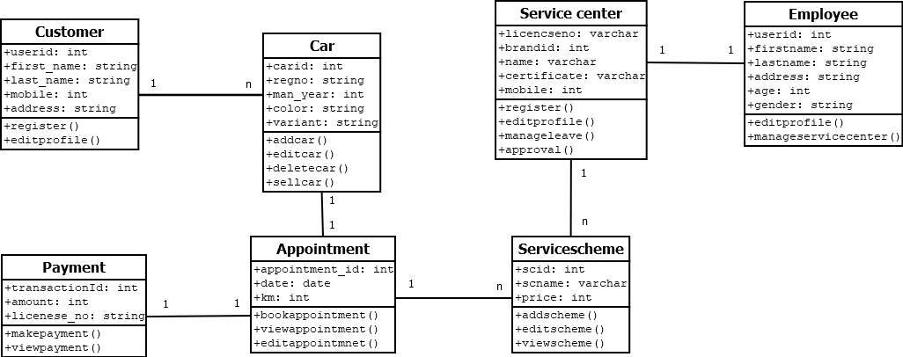
UML - Diagrams
Structural Diagrams
1. Class diagram

Slide 21
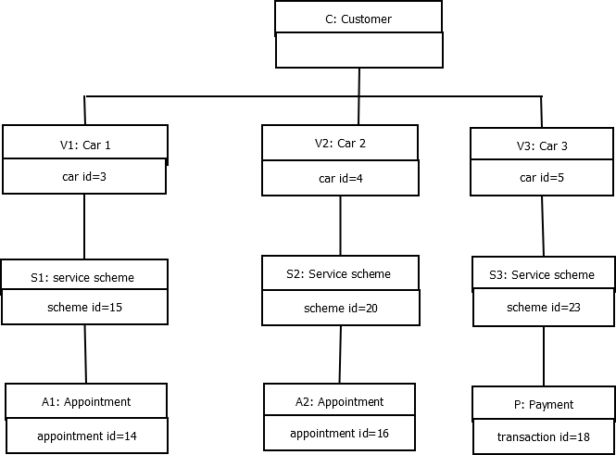
2. Object diagram

Slide 22
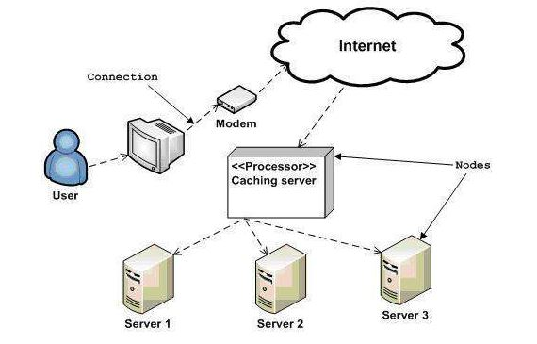
3. Deployment diagram

Slide 23
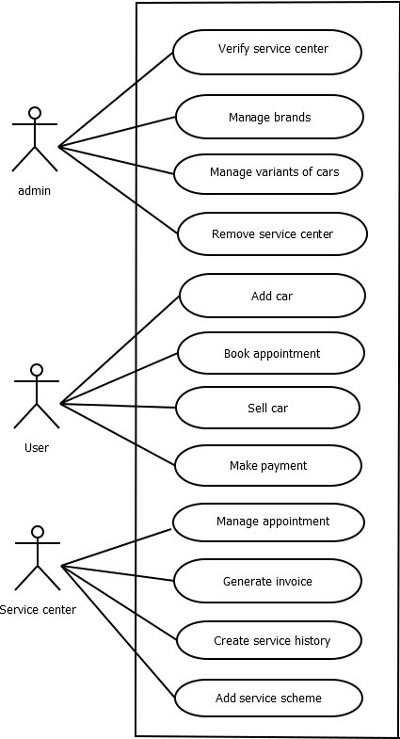
Behavioural Diagrams
1. Behavioural Diagrams

Slide 24
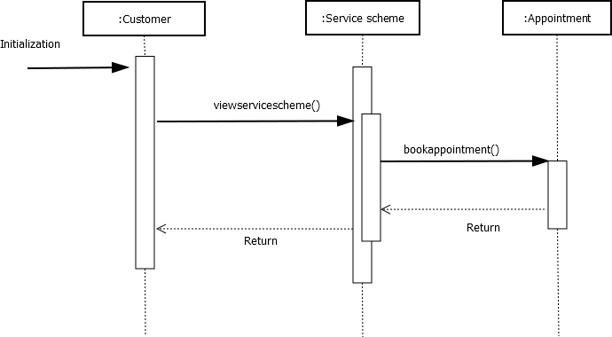
2. Sequence diagram

Slide 25
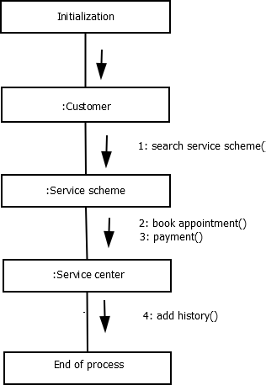
3. Collaboration diagram

Slide 26
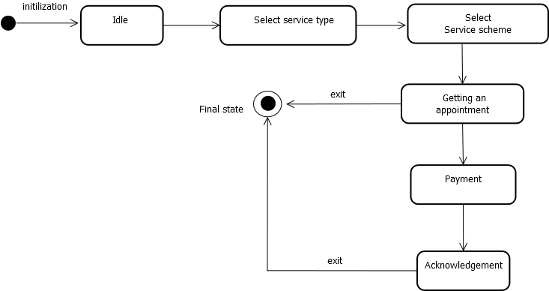
4. State chart diagram

Slide 27
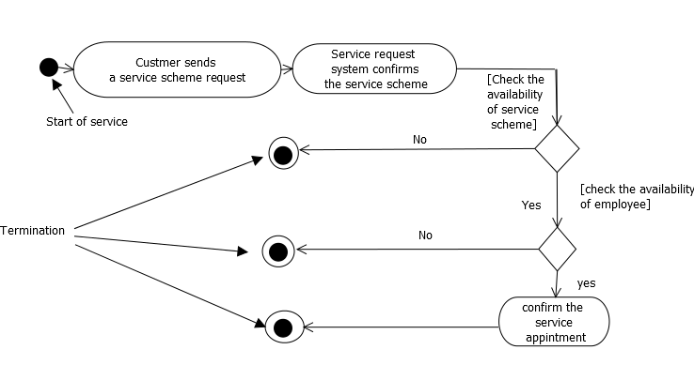
5. Activity diagram

Slide 28
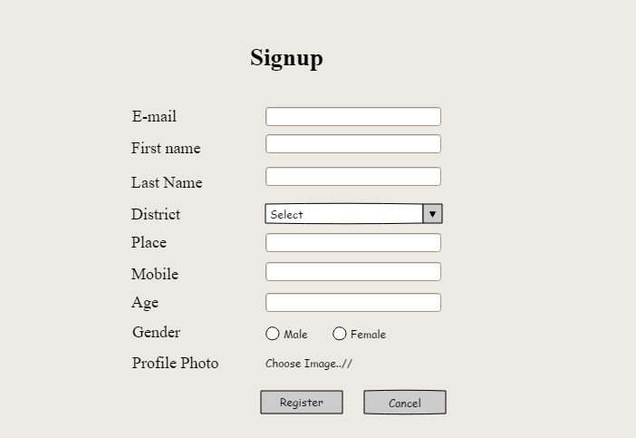
FORM DESIGN

Slide 29
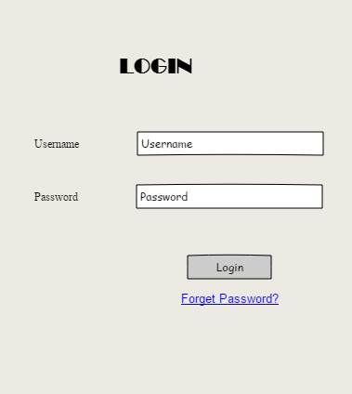

Slide 30
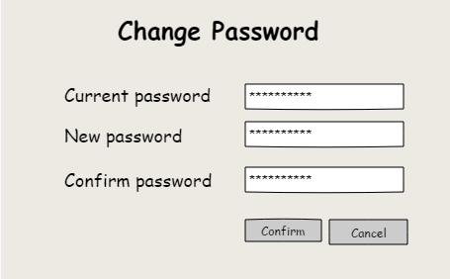

Slide 31
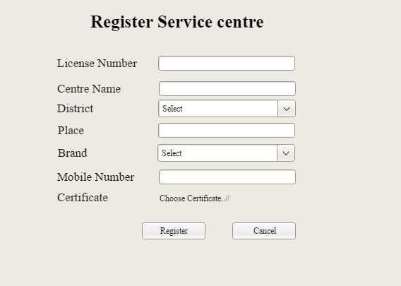

Slide 32
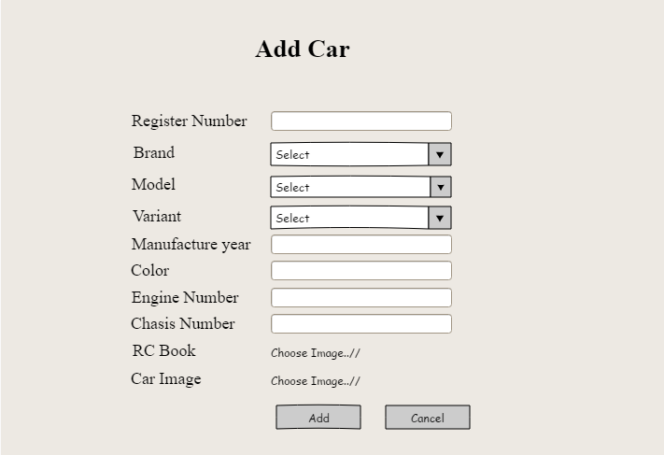

Slide 33
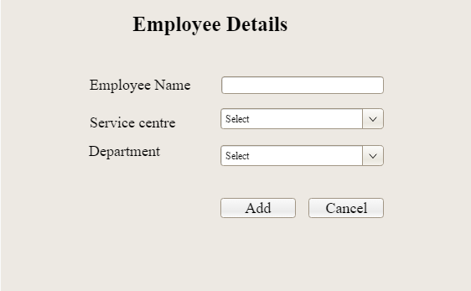

Slide 34
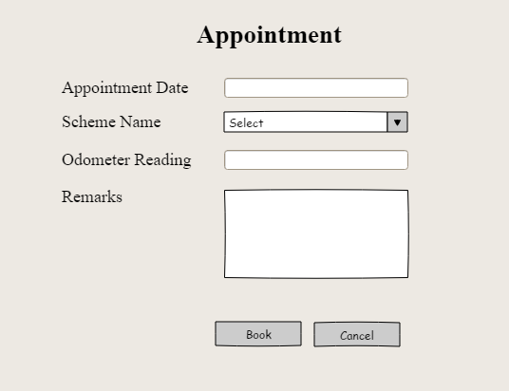

Slide 35
